Slide 1
Week 09
NCTU Deep Learning

Slide 2
Mostly
Chapter 12

Slide 3
Fast Implementations
CPU
  Exploit fixed point arithmetic in CPU families where this offers a speedup
  Cache-friendly implementations
GPU
  High memory bandwidth
  No cache
  Warps must be synchronized
TPU
  Similar to GPU in many respects but faster
  Often requires larger batch size
  Sometimes requires reduced precision

Slide 4
Distributed Implementations
Distributed
  Multi-GPU
  Multi-machine
Model parallelism
Data parallelism
  Trivial at test time
  Synchronous or asynchronous SGD at train time

Slide 5
Synchronous SGD
TensorFlow tutorial

Slide 6
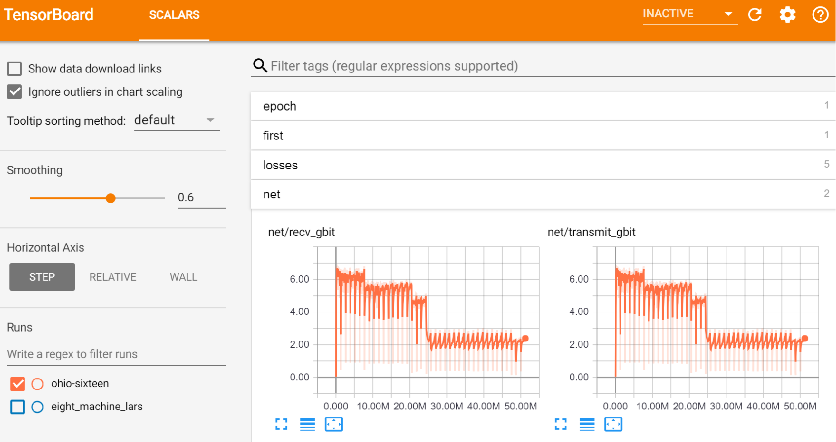
Example: ImageNet in 18 minutes for $40
Blog post

Slide 7
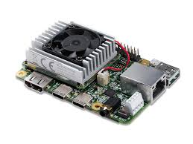
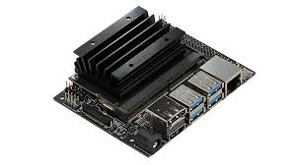
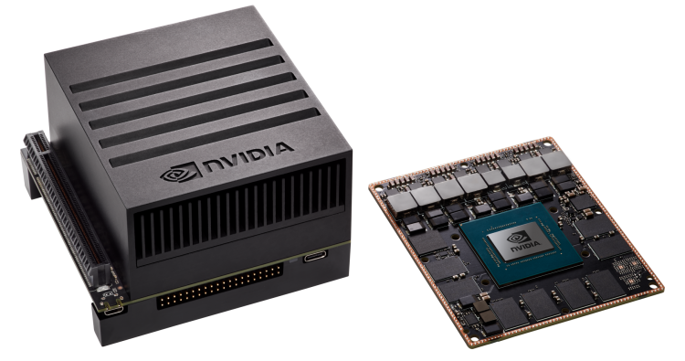

Slide 8
Model Compression
Large models often have lower test error
  Very large model trained with dropout
  Ensemble of many models
Want small model for low resource use at test time
Train a small model to mimic the large one
  Obtains better test error than directly training a small model

Slide 9
Quantization
Important for
mobile deployment
(TensorFlow Lite)

Slide 10
Normalization
Contrast Normalization
Standarization
Whitening
Decorrelation

Slide 11






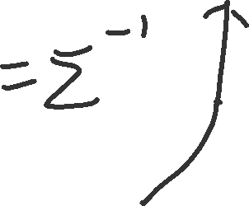


















Whitening

Slide 12




















Whitening

Slide 13
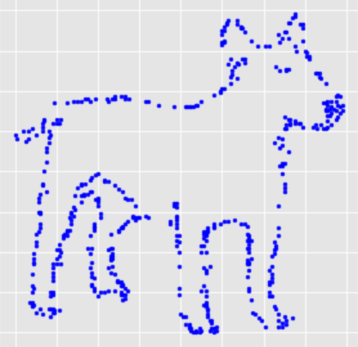
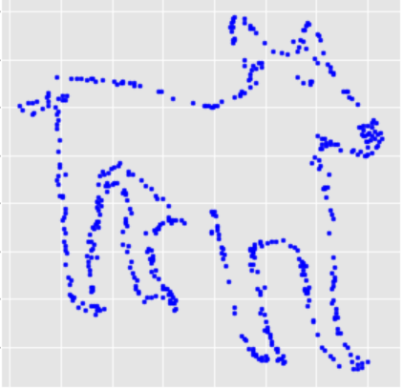
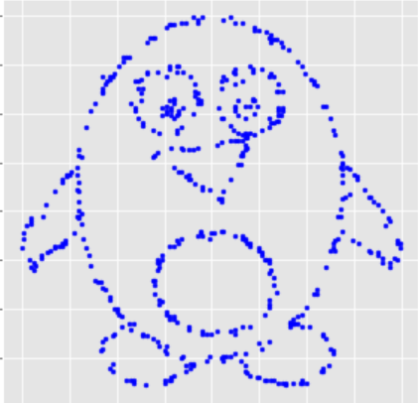
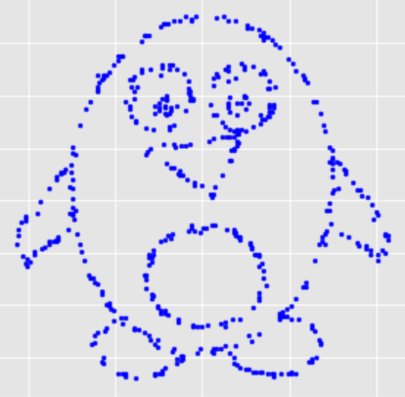
ZCA
https://github.com/tjwei/Animation-with-Identical-Statistics/blob/master/Animation%20with%20Identical%20Statistics.ipynb

Slide 14

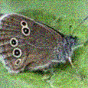
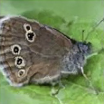


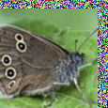

Dataset Augmentation for Computer Vision
Affine Distortion
Noise
Elastic Deformation
Horizontal flip
Random Translation
Hue Shift

Slide 15
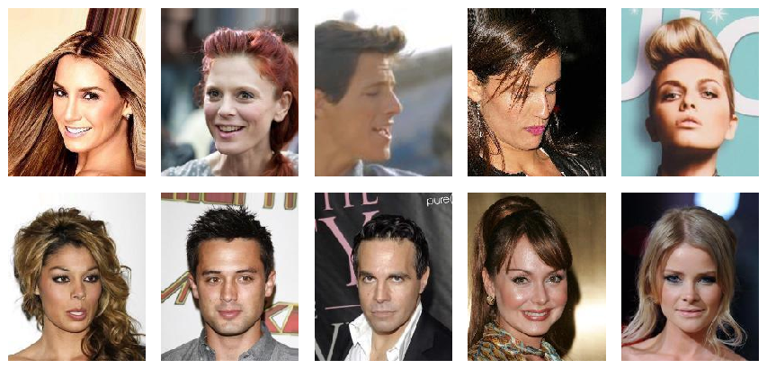
Generative Modeling: Sample Generation
Training Data
Sample Generator
(CelebA)
(Karras et al, 2017)
Covered in Part III
Progressed rapidly after the book was written
Underlies many graphics and speech applications

Slide 16
Graphics
(Table by Augustus Odena)

Slide 17
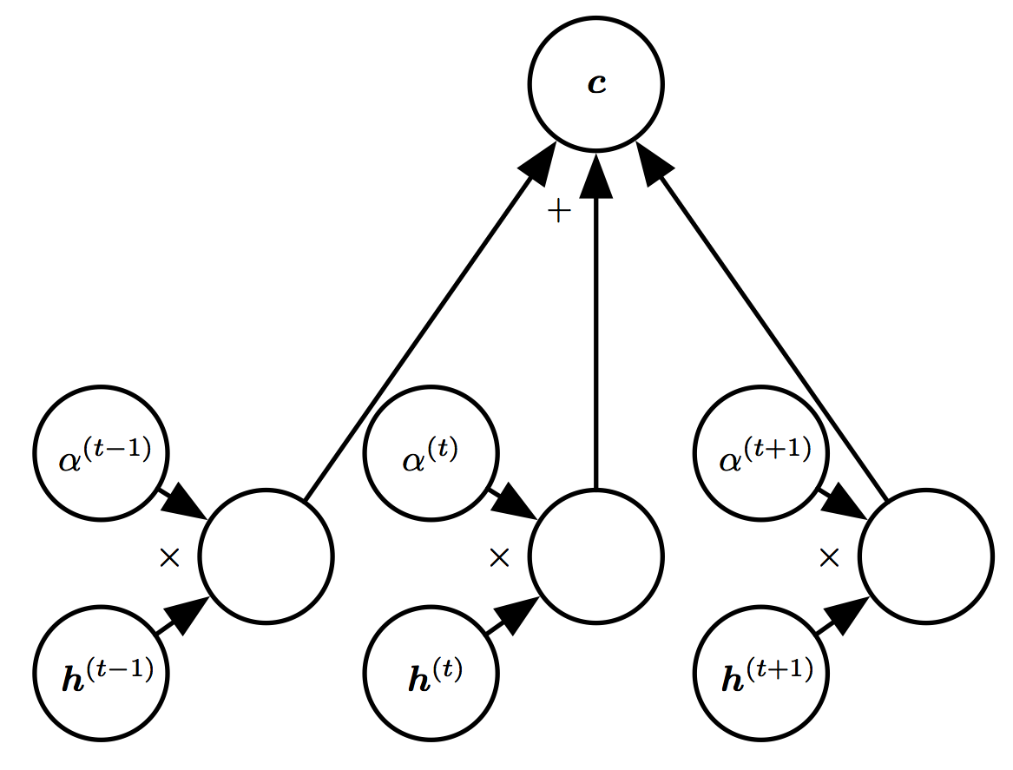
Attention Mechanisms
Figure 12.6
Important in many vision, speech, and NLP applications
Improved rapidly after the book was written

Slide 18
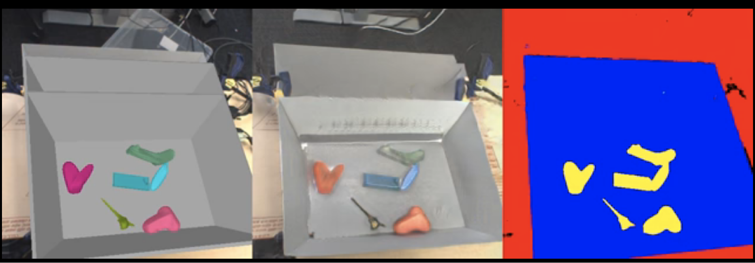
Generating Training Data
(Bousmalis et al, 2017)

Slide 19
Generating Training Data
(Bousmalis et al, 2017)

Slide 20
Attention for Images
Attention mechanism from
Wang et al 2018
Image model from Zhang et al 2018

Slide 21









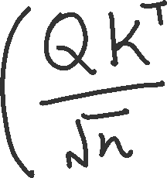





Attention

Slide 22








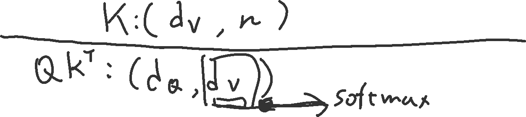



Attention

Slide 23
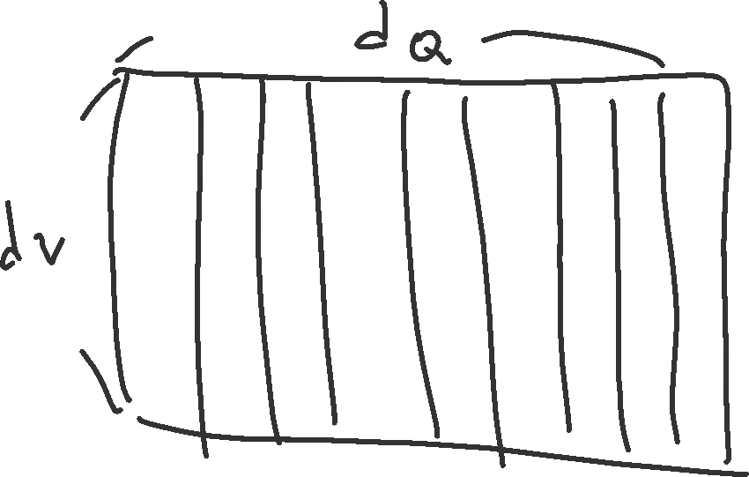










Attention

Slide 24
Natural Language Processing
An important predecessor to deep NLP is the family of models based on n-grams:
Improve with:
-Smoothing
-Backoff
-Word categories

Slide 25
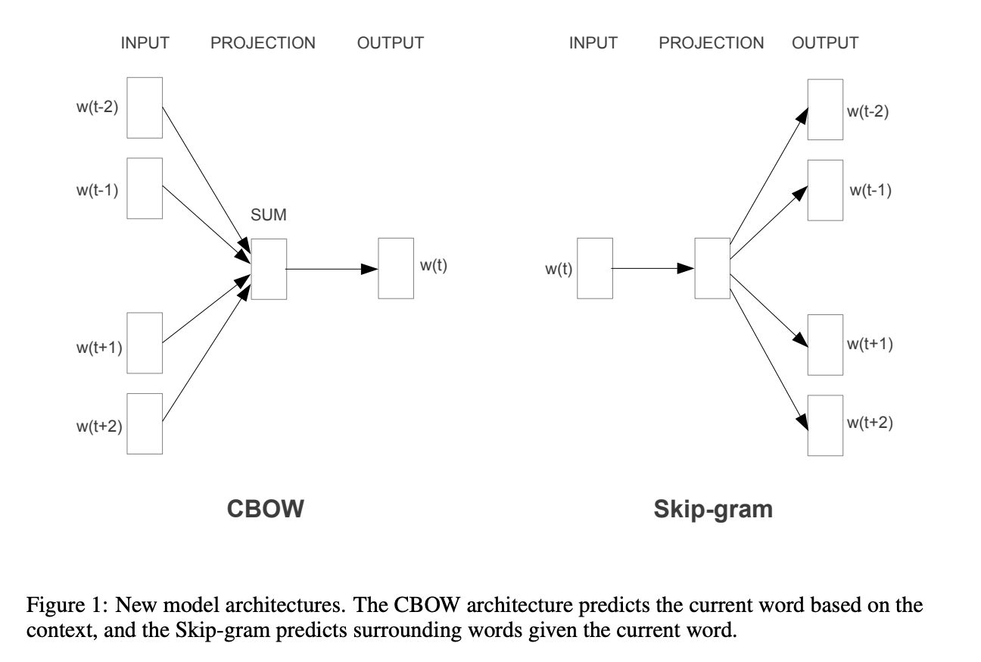
CBOW and Skip-gram

Slide 26
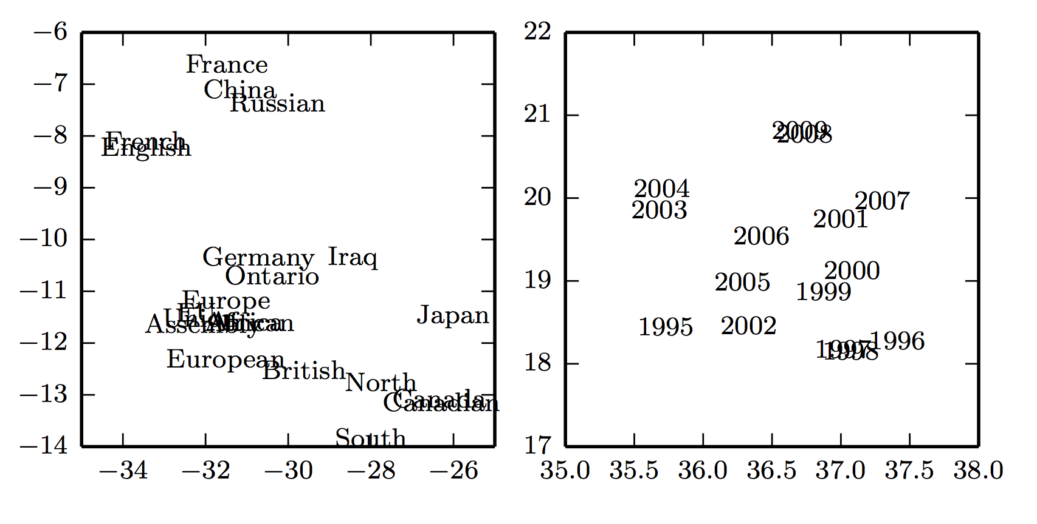
Word Embeddings
Figure 12.3

Slide 27
High-Dimensional Output Layers for Large Vocabularies
Short list
Hierarchical softmax
Importance sampling
Noise contrastive estimation

Slide 28
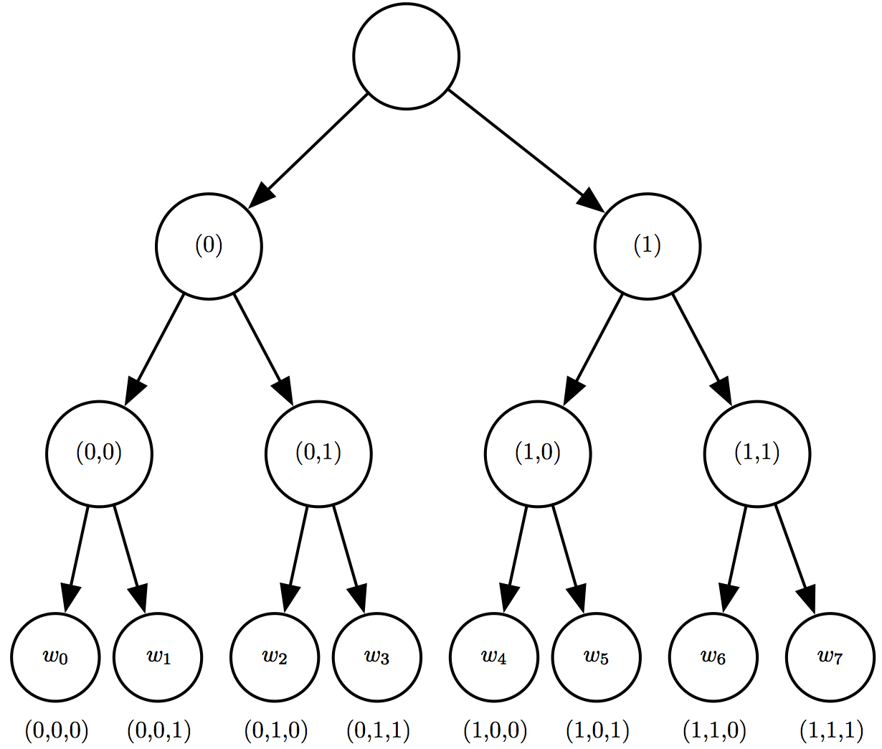
A Hierarchy of Words and Word Categories
Figure 12.4

Slide 29
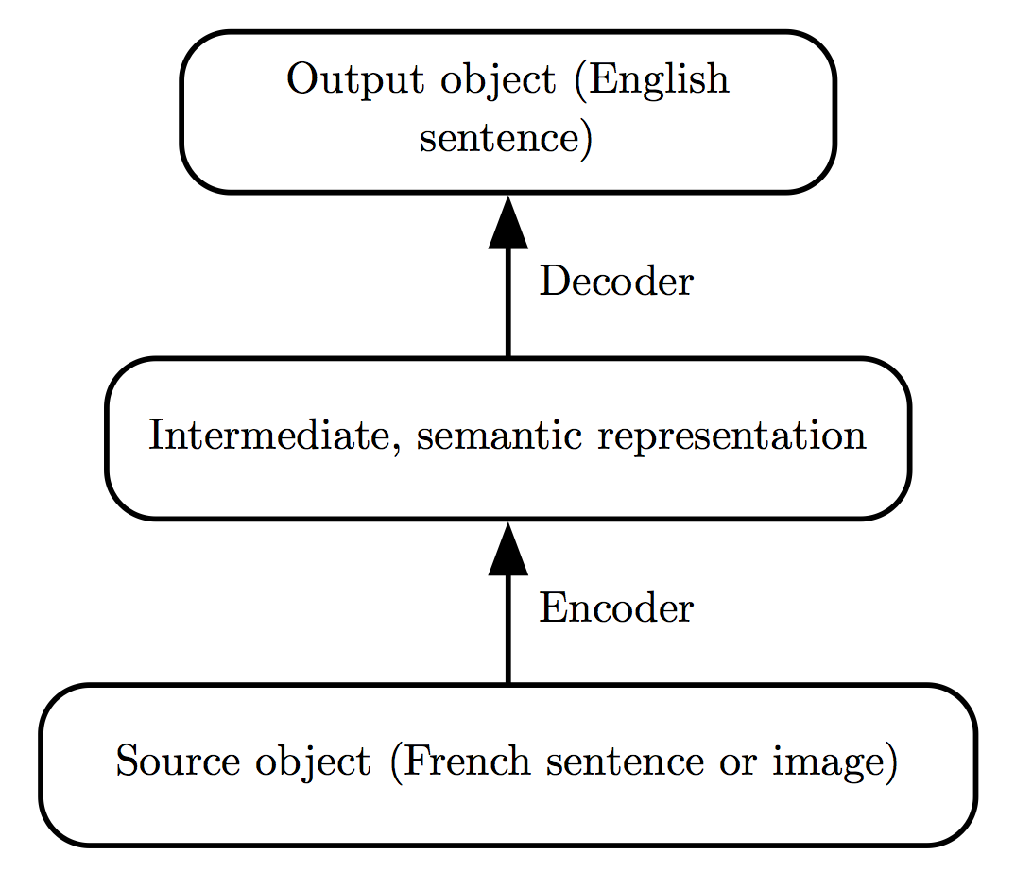
Neural Machine Translation
Figure 12.5

Slide 30
Google Neural Machine Translation
Wu et al 2016

Slide 31
Speech Synthesis
WaveNet
(van den Oord et al, 2016)

Slide 32
Speech Recognition
Current speech recognition
is based on seq2seq with
attention
“Listen, Attend, and Spell”
Graphic from
Chan et al 2015

Slide 33
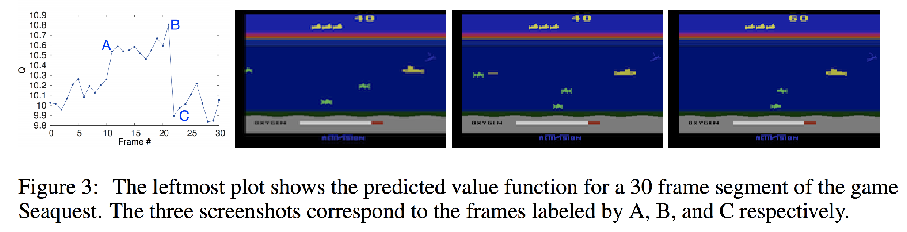
Deep RL for Atari game playing
(Mnih et al 2013)
Convolutional network estimates the value function (future rewards) used to guide the game-playing agent.
(Note: deep RL didn’t really exist when we started the book,
became a success while we were writing it, extremely hot topic by the time the book was printed)

Slide 34
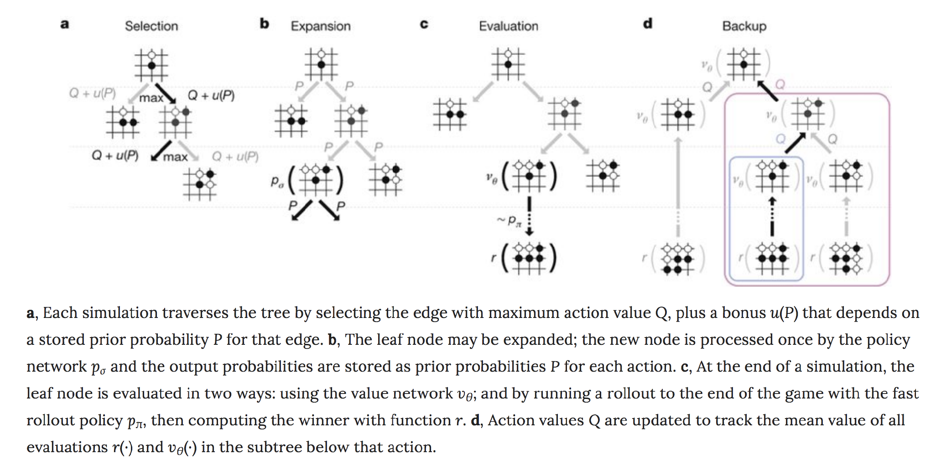
Superhuman Go
Monte Carlo tree search, with convolutional networks for value function and policy
(Silver et al, 2016)

